Slide 1
Docker for Local Development

Slide 2
Introduction to Docker
What is Docker?
Why is it important?

Slide 3
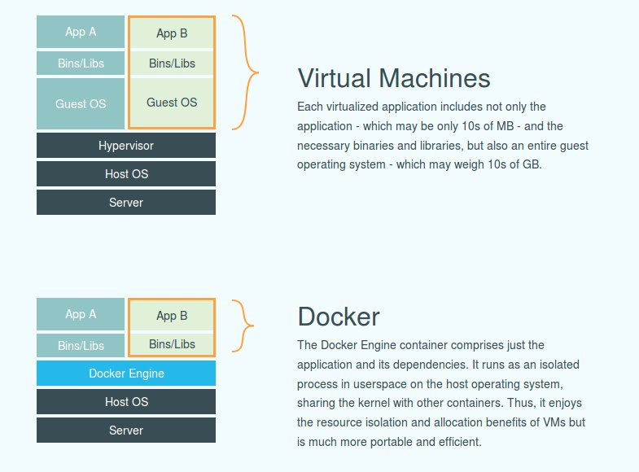

Slide 5
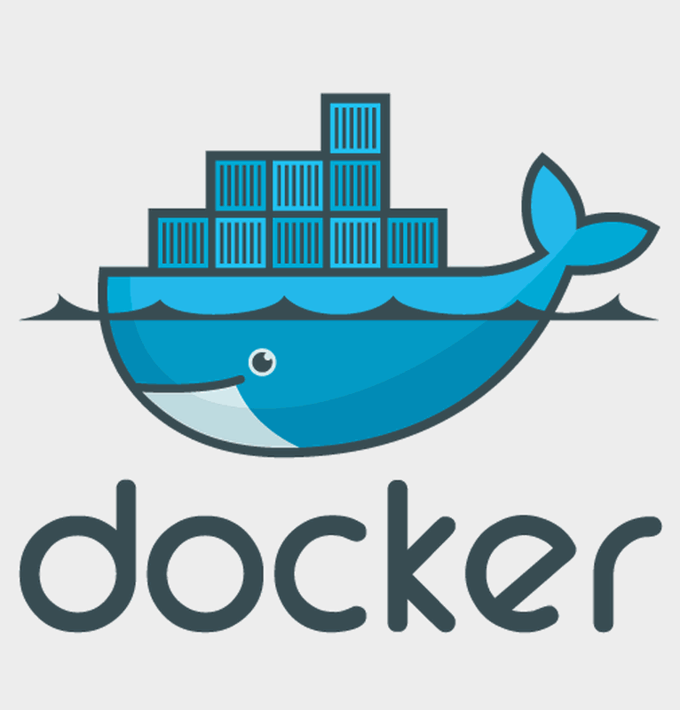
Understanding Docker Components
Docker images
Docker containers
Docker hub

Slide 6
One Command Setup
How to set up SQL Server, Redis, RabbitMQ, etc., using Docker
Docker file example

Slide 7
Benefits of Using Docker
Isolation of environment
Quick setup and teardown
Resource efficiency

Slide 8
Getting Started with Docker

Slide 9
Conclusion and Q&A

Slide 10
THANK YOU

